Slide 1
Opening of new catering distributor centers in Minsk, Belarus
XXXX Company

Slide 2
Introduction/Business Problem
XXXX distribution company decided to open its representative office in Minsk to sell various products for catering: kitchen and restaurant equipment, reusable and disposable tableware. In addition, it imports and sells premium coffee, tea and various snacks, etc. It is expected that about 5 warehouses will be opened in the city, from which goods will be delivered to the nearest points of sale.
The objective of the study is to identify areas for each of the 5 points that will optimally correspond to the logistics tasks.

Slide 3
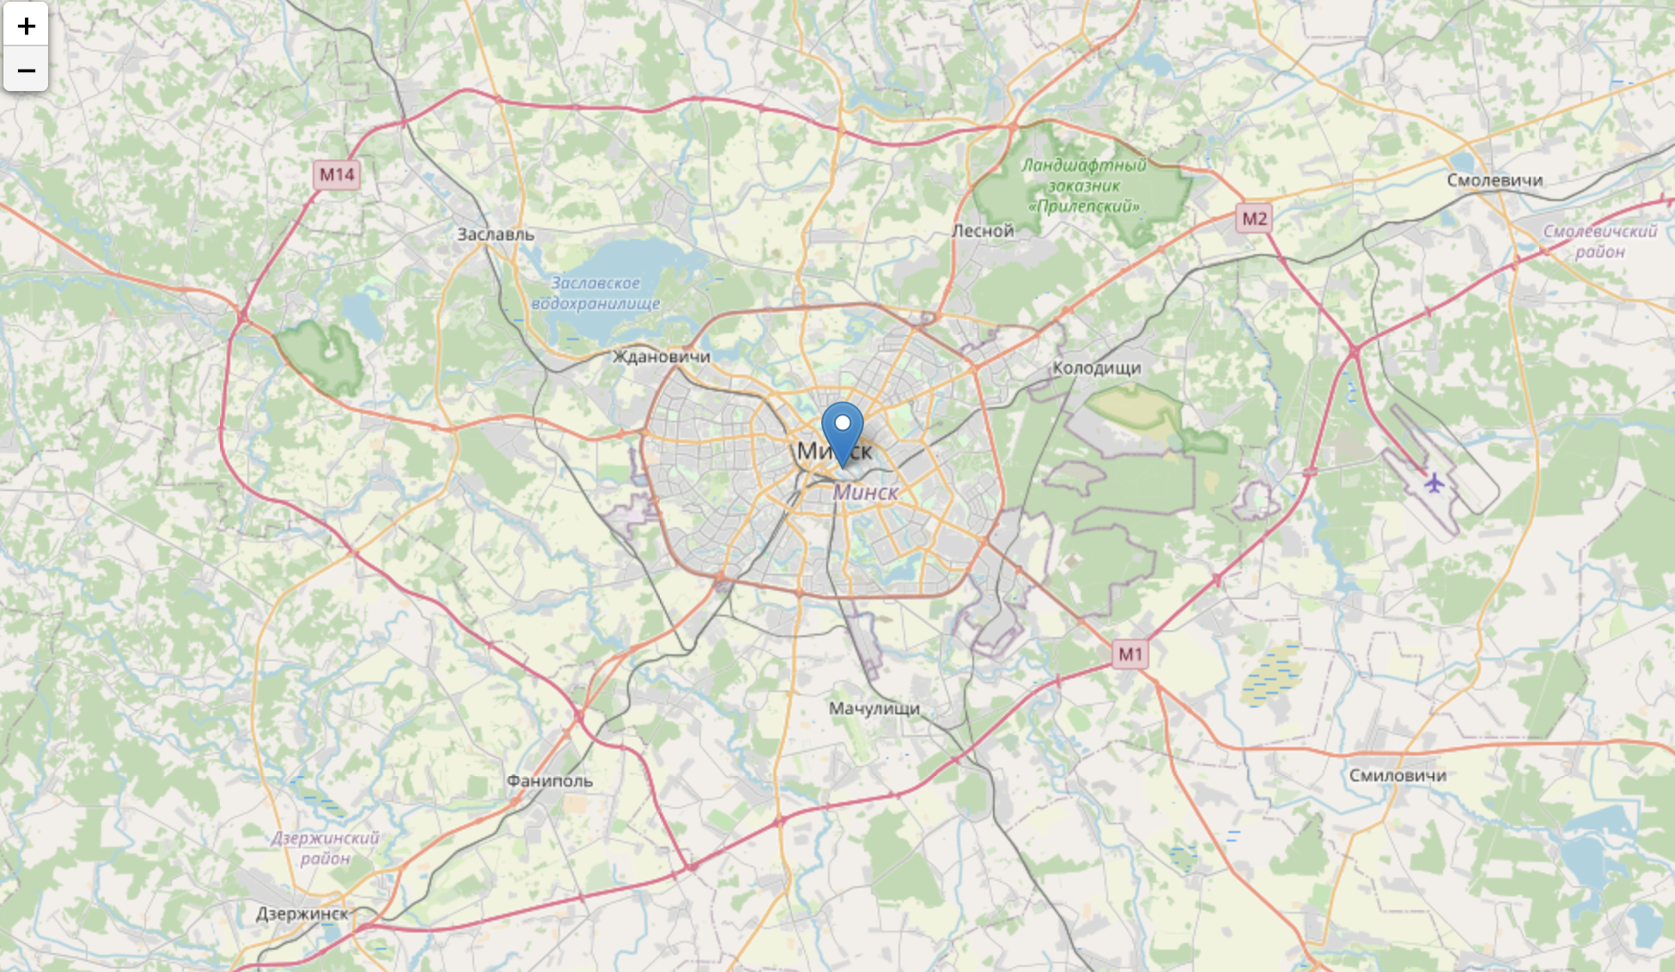
Our region on the map

Slide 4
Venues statistic:
Number of postal codes in Minsk: 58
Area: Minsk in nearest 15 KM
Number of venues for researching: 199
Most popular types:
- 18 Gym / Fitness Center
- 14 Coffee Shop
- 10 Park
- 7 Bookstore, 7 Hotel
- 6 Café
-5 Multiplex, 5 Cocktail Bar, 5 Spa, 5 Wine Bar
- 4 Arcade, 4 Bakery, 4 Bar, 4 Flower Shop, 4 Beer Bar…….

Slide 5
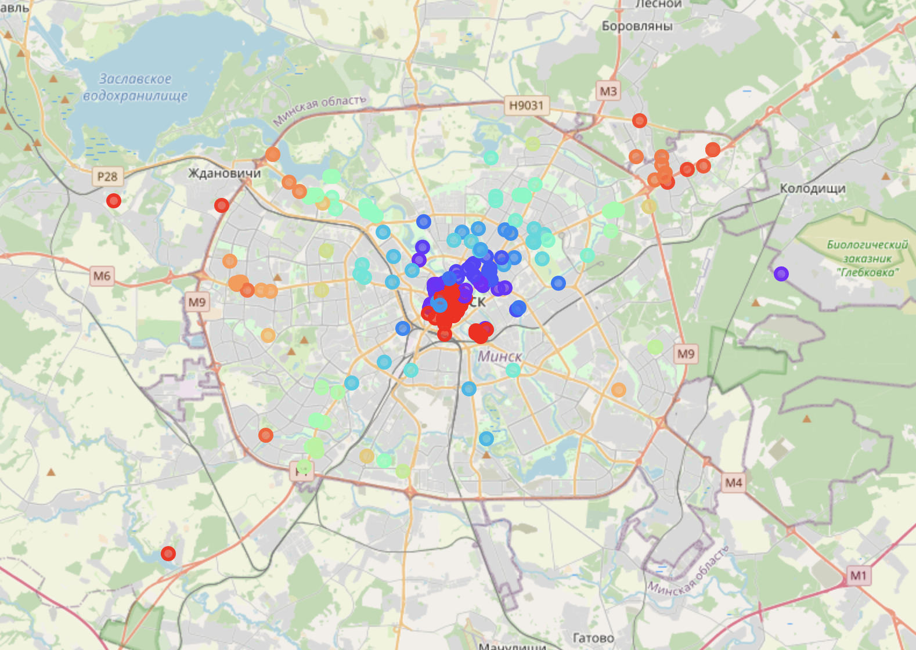
All venues based on postal codes:

Slide 6
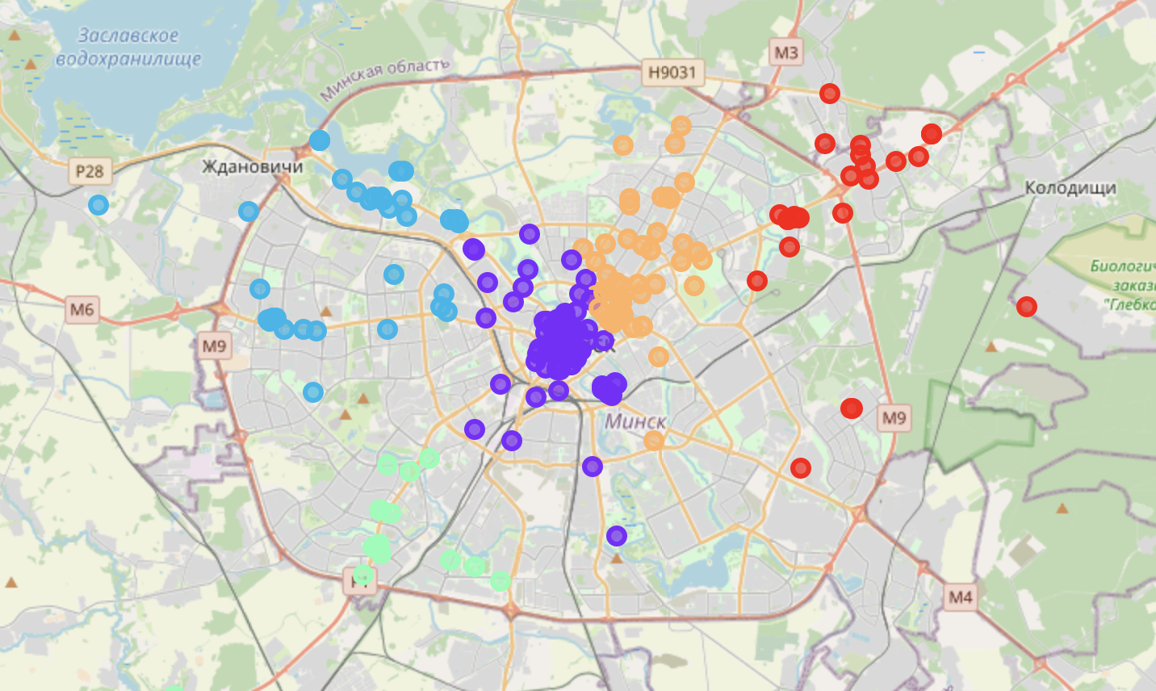
Need only 5 warehouses that will be opened in the city, from which goods will be delivered to the nearest points of sale. And here they are!

Slide 7
All venues based on postal codes:

Slide 8
Conclusion: We received 5 equivalent areas in which the customer can place their centers. Given the specifics of the area / development / property prices, the customer now needs to find a suitable place in this area where his warehouse / office will be located. But that's another story :)

